Slide 1


BAN 210 – FINAL ASSESSMENT
TOPIC: BREAST CANCER DATASET
Submitted by: Nishalben Krutay Joshi
Student id: 158865212
Subject: Predictive Analytics (BAN210ZAA)

Slide 2

Agenda
OBJECTIVES
STAGES FOR CONDUCTING THE DESIRED ANALYSIS
FINDINGS
DECISION TREE & NEURAL NETWORK
MODEL COMAPRISION
CONCLUSION

Slide 3
OBJECTIVES
This analysis of the breast cancer data set aims to determine which characteristics are most useful in the prediction. It also aims to find which model is performing better with good accuracy.

Slide 4
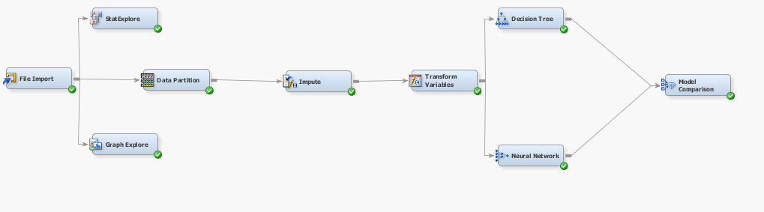
STAGES FOR CONDUCTING THE DESIRED ANALYSIS
EDA:
File import
Stat Explore
Graph Explore
Data Partition
Impute
Transform Variables
Predictive Analytics :
Decision Tree
Neural network
Model Comparison

Slide 5
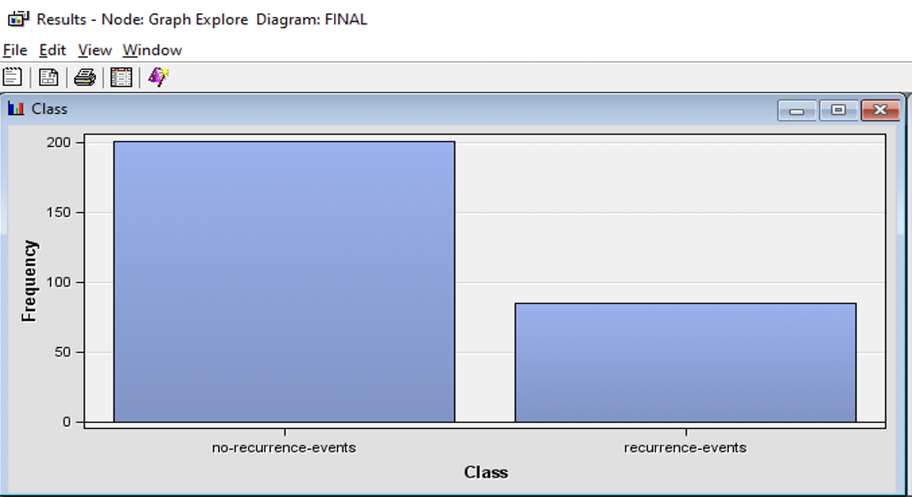
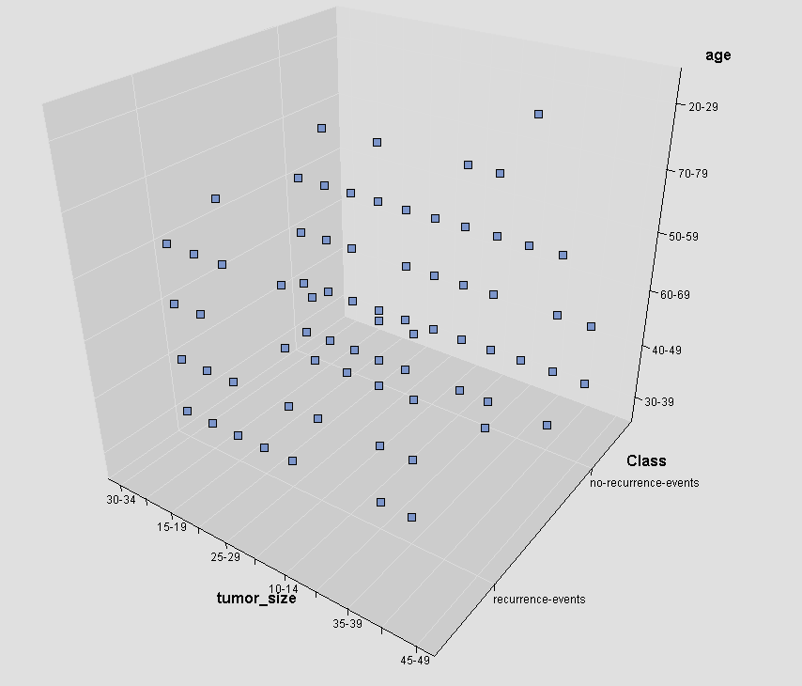
FINDINGS
The frequency of recurrence events in this case is 86 the target for this case of consideration is chosen as class
The 3D scatter plot which is shown below is constructed by taking X as class, Y as Tumor size and Z as Age.

Slide 6
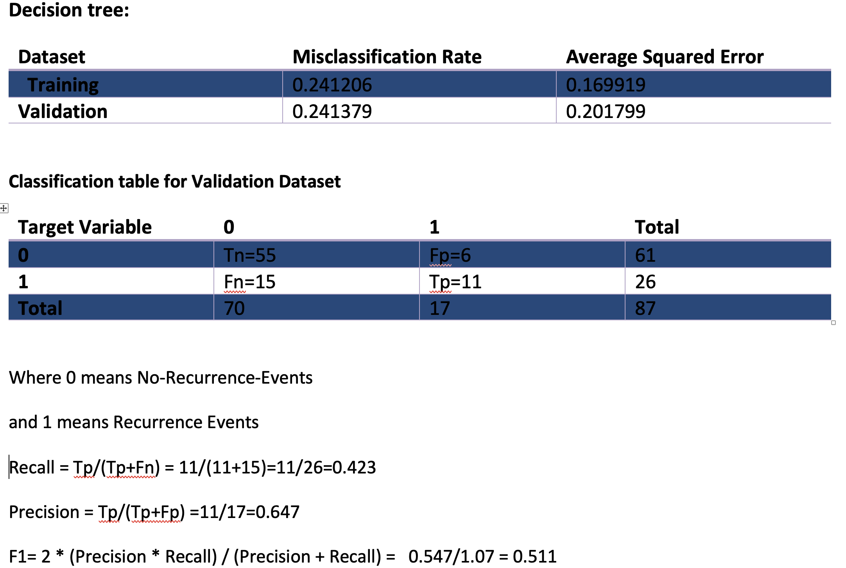
DECISION TREE
F1 Score tells about the model accuracy so the f1 score for this decision tree is 0.511

Slide 7
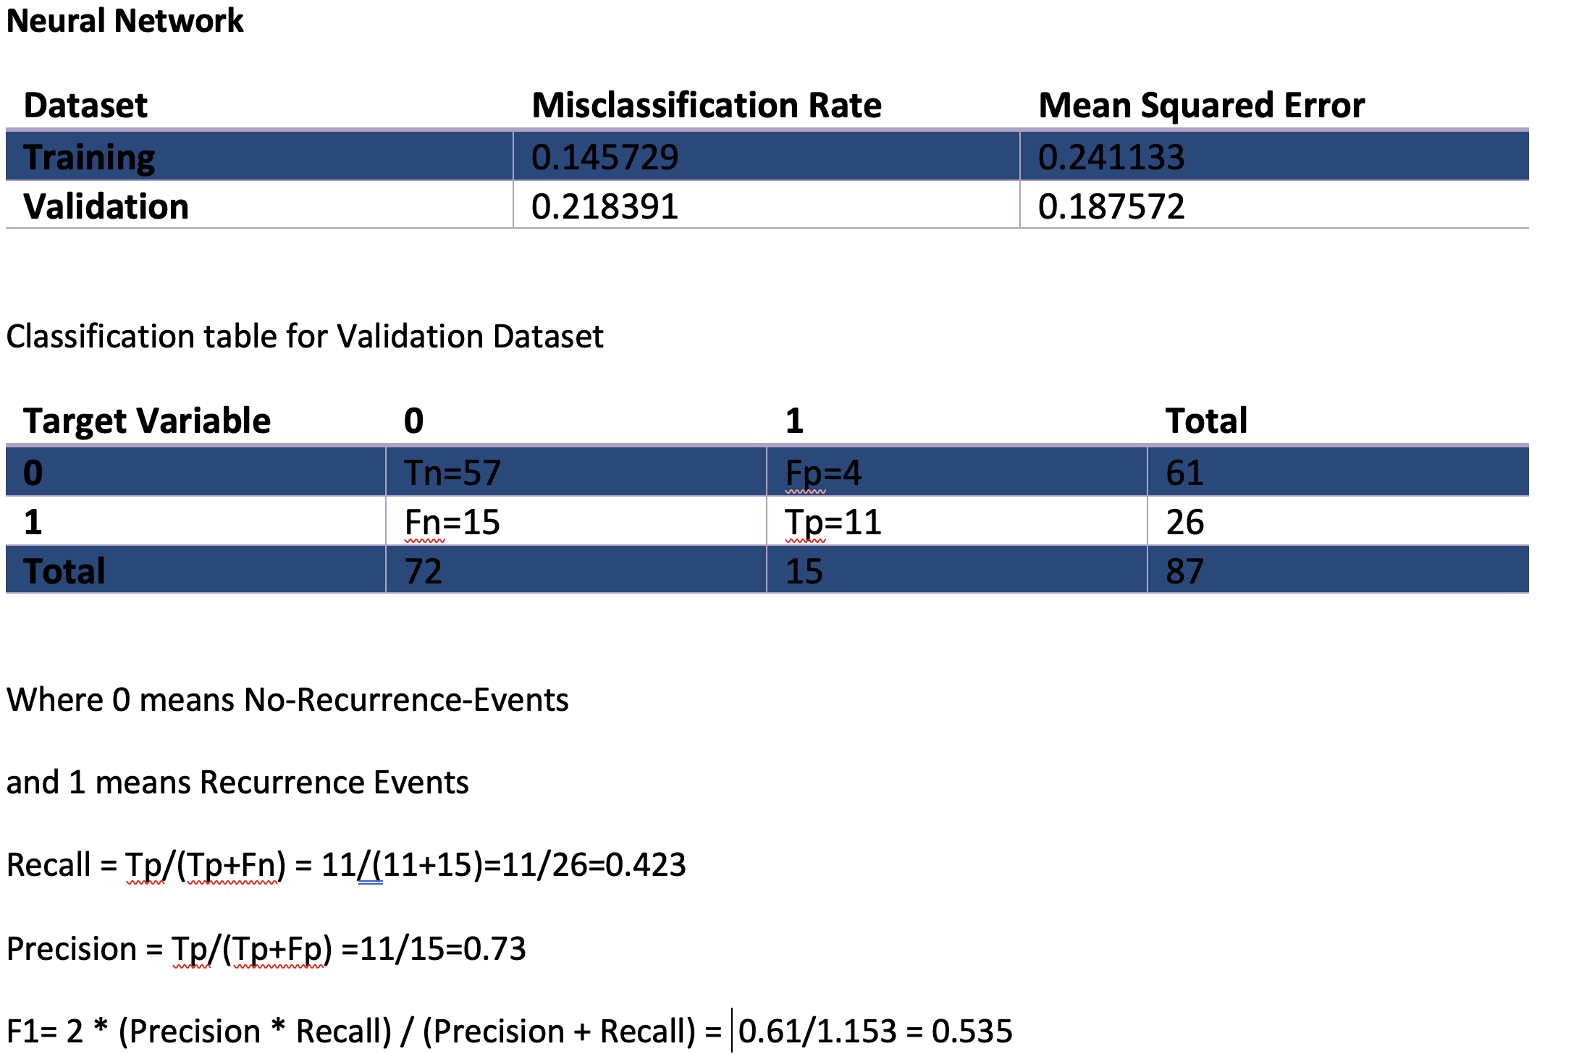
Neural Network
F1 Score tells about the model accuracy so the f1 score is 0.535

Slide 8
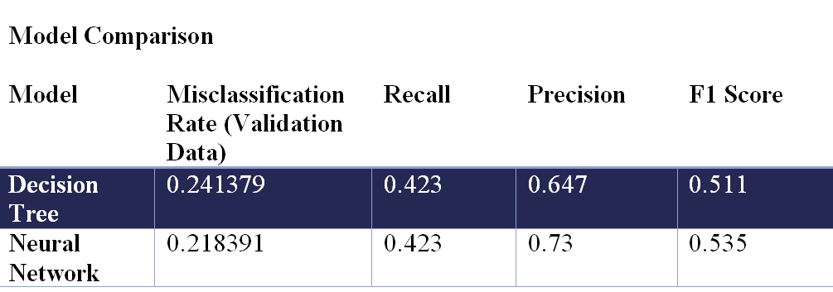
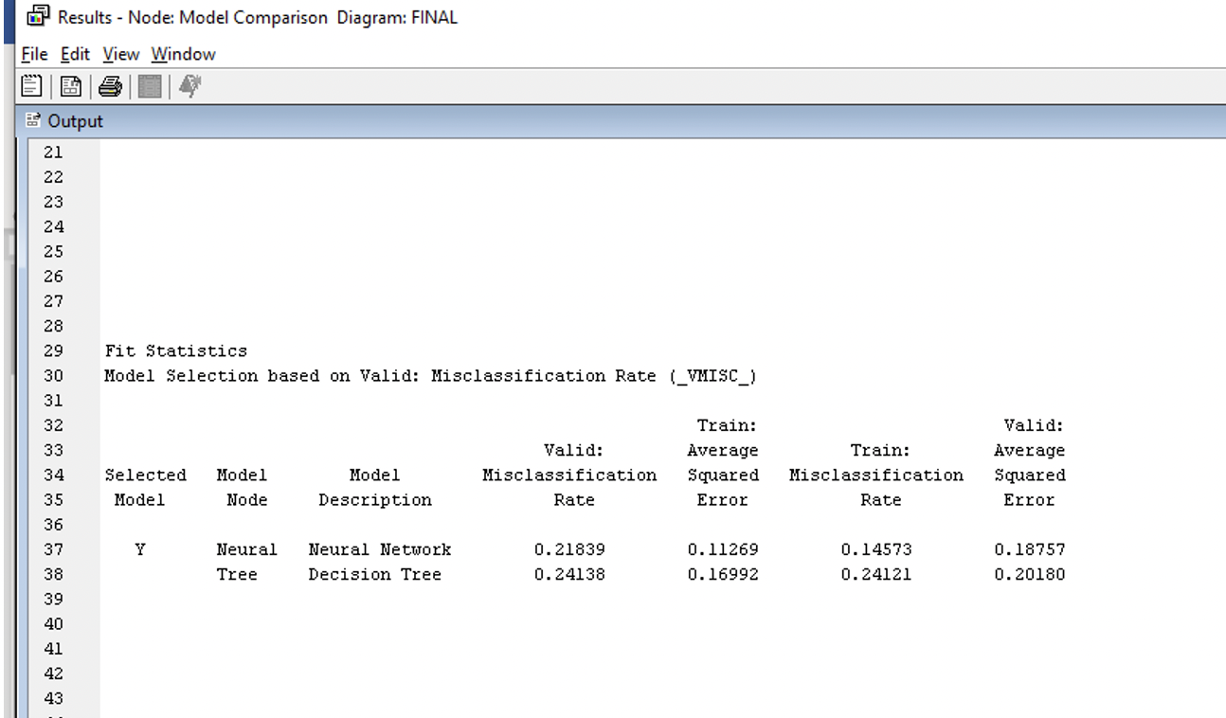
Model Comparison
The calculated F1 score proves that Neural network model is much better than the decision tree model
On the other hand, The model comparison node also provides the same results I.e, neural network is a better model.

Slide 9
Conclusion
When the validating set of data is sorted and structured in descending order, neural networks perform more effectively in terms of score ranking result. Additionally, for this reason, we can assert that the neural network is a superior model to the decision tree.

Slide 10

THANK YOU

